Slide 1
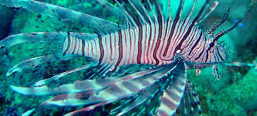

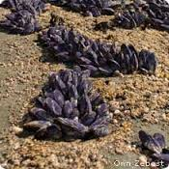
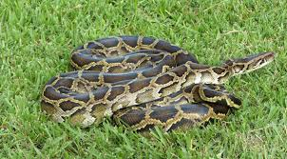
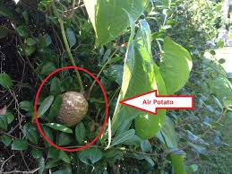
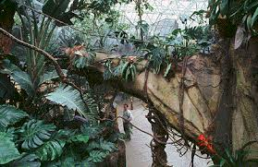
Alien Species
V.S.
Notes:
Alien species. When people think about the word “alien species”, their minds usually wander to little green aliens or other scary movie creatures, but should we be more concerned about little green extraterrestrials or foreign species such as introduced invasive plants and animals from other countries?

Slide 2
Is the introduction of foreign species detrimental?
Candidate# 2285
Notes:
This brings me to our group’s question “Is the introduction of foreign species detrimental?” We chose this because this is a huge problem in our home state, Florida. It is estimated that 26% of all mammals, birds, reptiles, amphibians, and fish are not native to the region. This makes South Florida one of the largest non-native species communities in the world. This is important because it is estimated that hundreds of billions of dollars in the US goes to damage and control of invasive species annually.

Slide 3
Foreign Species
Plant
Fungus
Animal
Notes:
For the purpose of this research, we defined foreign species as a plant, fungus, or animal species that is not native to a specific location. (Invasive species, 2016) Species move away from their natural habitants in many ways varying from natural migration to human displacement. Therefore there are many positive and negative aspects of the introduction of foreign species.

Slide 4
Thesis
*Solve preexisting problems
*Less biodiversity
*Over population
Notes:
I was researching the environmental aspect of this issue and I found that while sometimes they can fix preexisting problems, the fact that they are the cause of a less biodiverse and over populated environment is more detrimental.

Slide 5
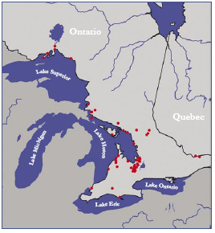
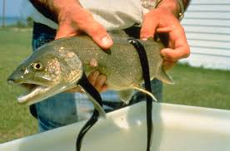
Less Biodiversity Example 1
(Sea Lamprey Quebec, 2016)
(Sea Lamprey Quebec, 2016)
Notes:
So the first reason the introduction of foreign species is detrimental to the natural environment is it can result in less biodiversity. An example of this would be sea lamprey. This information comes from Quebec Biodiversity Website which is a project taken on by the Red Path Museum in Canada to educate people about studies featuring biodiversity, how we are effecting it, and how to preserve biological diversity worldwide. Their website says that Sea Lamprey, which are predators, were introduced into the Great Lakes system and their presence was the main reason why lake trout were wiped out from the upper Great Lakes in the mid-1900s. Without Sea Trout and the addition of sea lamprey, this results the whole Great Lakes eco system to be out of whack and all of the other organisms to either grow because they lack a natural predator or disappear completely because they have too many predators.

Slide 6
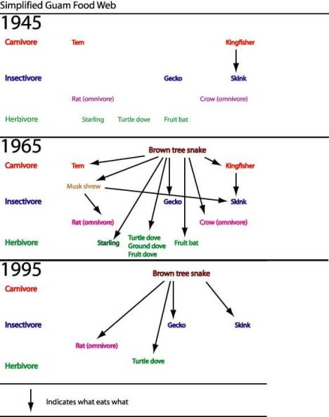
Less Biodiversity Example 2
Montgomery, H. (1999). Food Webs and the Introduction of Foreign Species. Retrieved April 20, 2016, from https://www.utdallas.edu/scimathed/resources/Melville/treesnake/Survivor.htm
Notes:
Another example of the introduction of a foreign species resulting in less biodiversity is the introduction of Brown Tree Snakes in Guam. As you can see from this food web, in 1945, Guam was diverse and didn’t have problems with dying species or over population, however in 1965, the brown tree snake was introduced. The brown tree snake was a predator to almost all species and was detrimental to the ecosystem and the biodiversity. In 1995, you can see this because all of the previous species that used to call this ecosystem their home, were wiped out from the area. Dr. Homer Montgomery went to and teaches at the University of Texas at Dallas and received his PhD in Biology, not specifically ecosystems in Guam, but he has been a part of many highly credible scientific studies. This is an important example, because it makes it very clear how the edition of foreign species can mess up the balance of an ecosystem and reduce biodiversity.

Slide 7
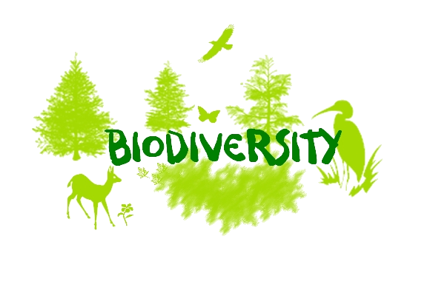

So why is Biodiversity Important?
Notes:
So why is biodiversity important? According to the Global World Wildlife Federation, “biological diversity is the resource upon which families, communities, nations and future generations depend on.” It links everything into a dependent web of life, so if something goes wrong, we are all in danger. To put this simply, if biological diversity is reduced, then millions of people will face hardships in their future such as limited food supplies and fresh water and more pests and diseases. In short, biodiversity is very important for our planet and our own health and wellbeing and the introduction of foreign species can reduce it and therefore threatens us.

Slide 8
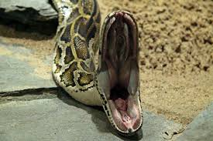
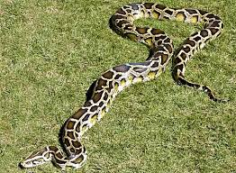
Dangerous to Humans Example 1
Interesting fact: Burmese python hatchlings are 18” long and the longest one captured in south Florida was 18’8”.
(Python Patrol, 2016)
(Burmese Pythons, 2016)
(Burmese Pythons, 2016)
Notes:
Another reason why the introduction of foreign species is detrimental to the natural environment is because they can be dangerous to humans. An example of this would be in my home state Florida. According to the Humane Society, the largest animal protective agency in the United States, on July 1st, 2009 in Sumter County, a 2 year old girl was killed in her crib by an 8½ foot Burmese python. Burmese pythons are released in Florida after they get too big to be household pets or escape. They thrive in this type of environment and can grow to be very large. Because of this, they can be a nuisance and harmful as this example showed.

Slide 9
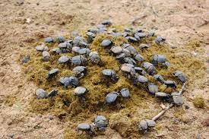
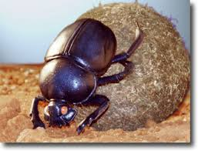
Gets rid of Preexisting Problems Example 1
(Dung Beetles, 2016)
(Dung Beetles, 2016)
Notes:
Now that I have made introducing foreign species sound so bad, I do have to mention that not all foreign species are bad. Many species are brought to certain locations to solve preexisting problems. An example of this would be Dung Beetles. According to Penny Edwards, Twenty three species of introduced dung beetle [from Africa and Europe] have [been] established in Australia primarily to bury cattle dung. An increase in the number of species is associated with a more sustained level of dung burial.” Even though there is not much information available about her education, Penny Edwards has worked at the CSIRO Dung Beetle Project for five years in South Africa and has received numerous awards for her findings. Dung burial is very important because in the soil it can act as a fertilizer, but if it just sits out, it attracts pests. In the case of a cows, pests are a big problem and when the dung beetles reduce the amount of dung and therefore pests, the overall wellbeing of the cows’ increases.

Slide 10

Gets rid of Preexisting Problems Example 2
(Kudzu, 2016)
Notes:
Another example of foreign species being beneficial is Kudzu. “Parts of the United States are covered by kudzu, a fast-growing vine native to southern and eastern Asia. According to John Rafferty, Kudzu was introduced into North America for erosion control and decorative purposes in the late 19th century. John P. Rafferty has his B.S. and M.S. in environmental sciences and has been a part of Encyclopedia Britannica for 10 years and is now the editor for Earth and Life Sciences. Erosion control is something the whole world is very concerned with because it means that the soil isn’t healthy and we want to preserve our land. So, the introduction of Kudzu was beneficial because it stops erosion.

Slide 11
Conclusion
Invasive Species
Notes:
In conclusion, I believe that the introduction of foreign species is detrimental to the natural environment because they can result in less biodiversity, and they can be dangerous to humans, even though the introduction of foreign species can get rid of preexisting problems. Living in Florida all of my life has exposed me to the dangers of what invasive species can do to an environment and a society, so I did go into this research already against the introduction of foreign species. However, I did find that they can be brought in for good reasons, such as getting rid of preexisting problems, avoiding extinction of a species, and for food (For example if a region doesn’t have very many edible fish and plants they could be introduced). After researching, I still believe that we should limit introducing new species into unnatural habitats.

Slide 12
Solution
Tax’s on Pets
Stricter Laws
More Hunting Rewards
Less invasive Species
Notes:
To stop further damage done by foreign species, globally we should have stricter laws prohibiting the introduction of foreign species. We should also try to solve the numerous problems already caused by foreign species by placing a tax on pets. This could also be used as a form of insurance if they get out like the Burmese Pythons. We should also put more hunting rewards out for invasive or foreign species to stop or reverse their harmful effects to our environment.

Slide 13
References
Edwards, P. (2007, July). Overview of Introduced Dung Beetles in Australia. Retrieved April 20, 2016, from http://www.landcareonline.com.au/wp-content/uploads/2010/10/Part-Two-Section-1-Overview-of-Introduced-Dung-Beetles-in-Australia.pdf
Invasive species. (2016). Retrieved April 13, 2016, from https://en.wikipedia.org/wiki/Invasive_species
Montgomery, H. (1999). Food Webs and the Introduction of Foreign Species. Retrieved April 20, 2016, from https://www.utdallas.edu/scimathed/resources/Melville/treesnake/Survivor.htm
Quebec Biodiversity Website. (2016). Impacts on Biodiversity. Retrieved April 14, 2016, from http://redpath-museum.mcgill.ca/Qbp/3.Conservation/impacts.htm
Rafferty, J. P. (2015, November 25). Invasive Species. Retrieved April 20, 2016, from http://www.britannica.com/science/invasive-species
Strayer, D. L. (2013, March 31). Invasive species pose serious danger to humans. Retrieved April 21, 2016, from http://www.caryinstitute.org/newsroom/invasive-species-pose-serious-danger-humans
The Human Society of the United States. (2012). Constrictor snake attacks. Retrieved April 20, 2016, from www.humanesociety.org/.../captive/constrictor-snake-attacks.pdf
Wild Florida - a series from WPBT Channel 2. (2016). Retrieved April 15, 2016, from http://www.wildflorida.tv/exotics/funfacts.html
WWF Global. (2016). How does Biodiversity loss affect me and everyone else? Retrieved April 20, 2016, from http://wwf.panda.org/about_our_earth/biodiversity/biodiversity_and_you/
Notes:
Here are my references. Thank you.

